Slide 1
Data Visualization

Slide 2
What is data visualization?
= the presentation of data, information, knowledge, or insight in a pictorial or graphical format

Slide 3
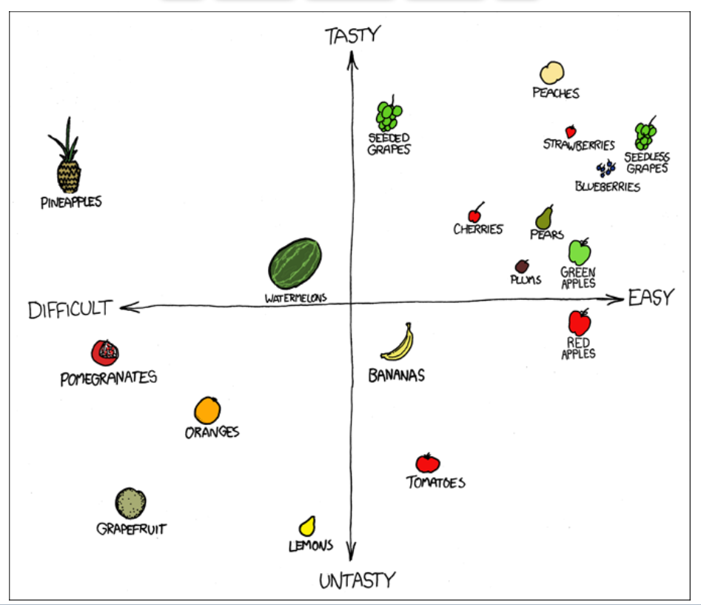
XKCD, “F^&% Grapefruit,” x-y chart

Slide 4
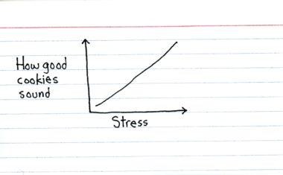
Jessica Hagy, ThisIsIndexed.com

Slide 5
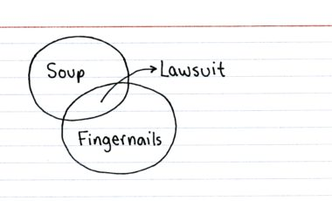
Jessica Hagy, ThisIsIndexed.com

Slide 6
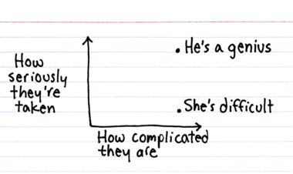
Jessica Hagy, ThisIsIndexed.com

Slide 7
Lying with Dataviz

Slide 8
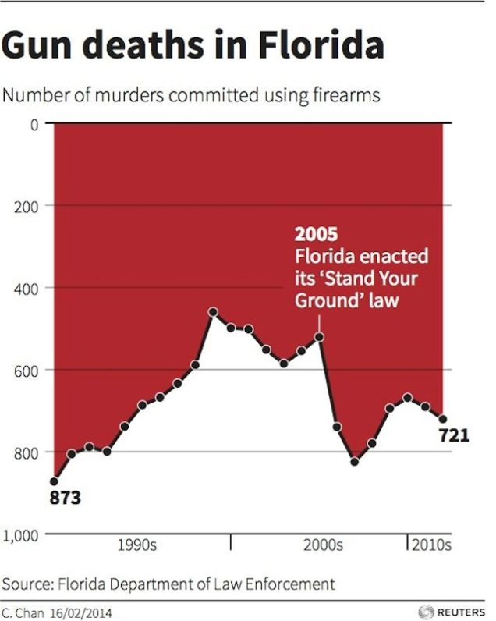
How to Lie with Data Visualization

Slide 9
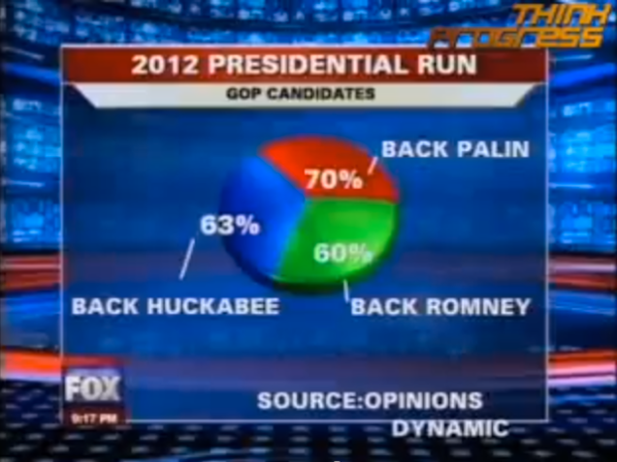
How to Lie with Data Visualization

Slide 10
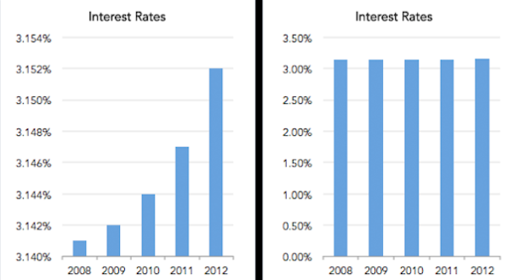
How to Lie with Data Visualization

Slide 11
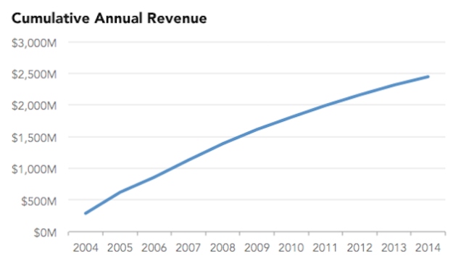
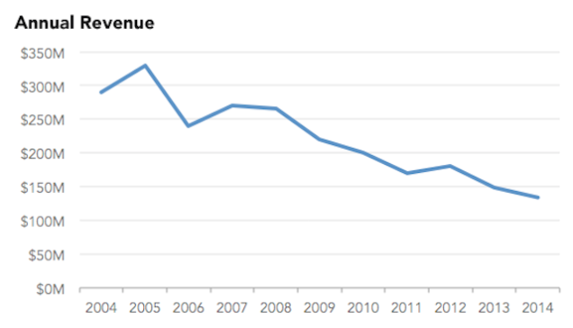
How to Lie with Data Visualizations
Cumulative revenue: running total of revenue earned to date (i.e. 2006 = 2006 + 2005 + 2004)
Annual revenue:
total revenue earned in current year (i.e. 2006 = 2006)
How to Lie with Data Visualization

Slide 12
DH-ing with Dataviz

Slide 13
Humanities Data
Semistructured
TEI-encoded text
Unstructured
A corpus of literary texts
Structured
Spreadsheet of catalogue entries
GIS data of locations on a map

Slide 14
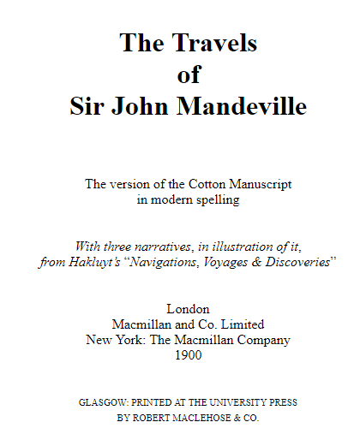
Humanities Data: Unstructured

Slide 15
Humanities Data: Semi-structured
<msDesc> <msIdentifier> <settlement>Oxford</settlement> <repository>Bodleian Library</repository> <idno>MS. Add. A. 61</idno> </msIdentifier> <msContents> <p> <quote>Hic incipit Bruitus Anglie,</quote> the <title>De origine et gestis Regum Angliae</title> of Geoffrey of Monmouth (Galfridus Monumetensis): beg. <quote>Cum mecum multa &amp; de multis.</quote> In Latin.</p> </msContents> <physDesc> <p> <material>Parchment</material>: written in more than one hand: 7¼ x 5⅜ in., I + 55 leaves, in double columns: with a few coloured capitals.</p> </physDesc> </msDesc>

Slide 16
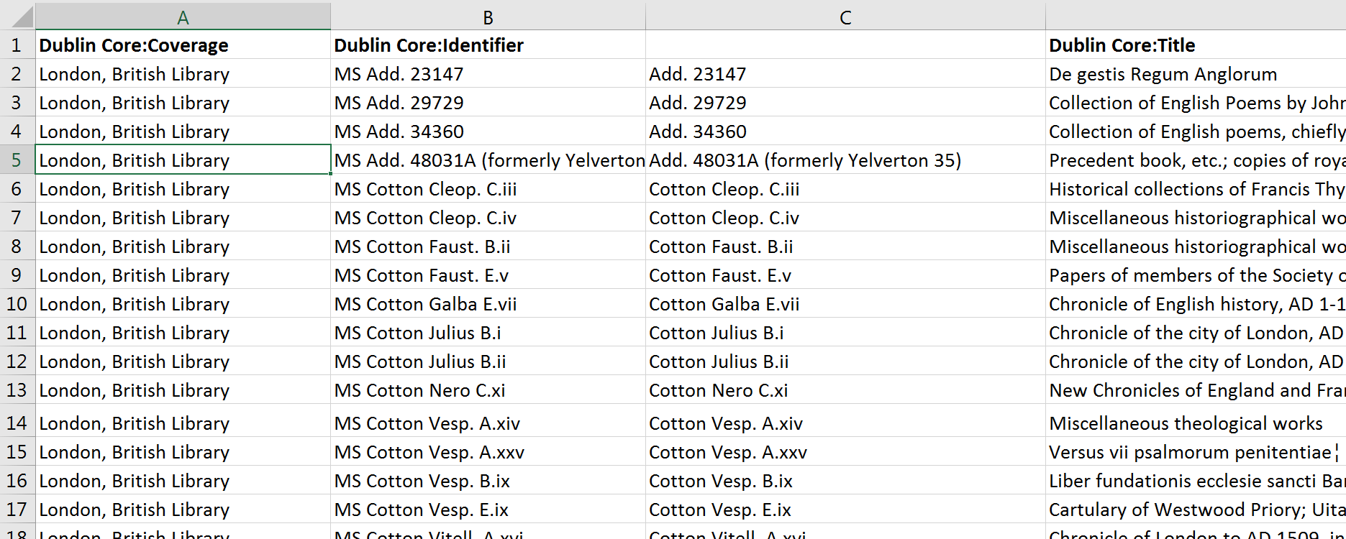
Humanities Data: Structured

Slide 17
Humanities Data:
What “counts” cannot necessarily be counted
Data representation = interpretation:
The process of modelling and collecting our data is an interpretive process that is shaped by our choices re. what aspects of the data we model; by our research question, argument, perspective, discipline, social context, institutional context, tools available etc.

Slide 18
Humanities’ Data
“When you call something data, you imply that it exists in discrete, fungible units; that it is computationally tractable; that its meaningful qualities can be enumerated in a finite list; that someone else performing the same operations on the same data will come up with the same results. This is not how humanists think of the material they work with.” (Miriam Posner, http://miriamposner.com/blog/humanities-data-a-necessary-contradiction/)

Slide 19
Humanities’ Data
“[DH visualization tools borrowed from the sciences] carry with them assumptions of knowledge as observer-independent and certain, rather than observer co-dependent and interpretative. […] To begin, the concept of data as a given has to be rethought through a humanistic lens and characterized as capta, taken and constructed.” Johanna Drucker, “Humanities Approaches to Graphical Display.”

Slide 20
Display as Argument: Visual Knowledge Creation
Data vs. Capta
Display as argument:
“Graphic artifacts present knowledge through the combination of symbolic codes and structured relations of these elements in a flat field. […T]he forms that are generally used for the presentation of information can be understood and read as culturally coded expressions of knowledge with their own epistemological assumptions and historical lineage” (Drucker, “Graphesis: Visual Knowledge Production and Representation,” 2011).

Slide 21
displays and visualizations =
“culturally coded expressions of knowledge with their own epistemological assumptions and historical lineage”

Slide 22
displays and visualizations =
“culturally coded expressions of knowledge with their own epistemological assumptions and historical lineage”
displays and visualizations =
“culturally coded expressions of knowledge with their own epistemological assumptions and historical lineage”

Slide 23
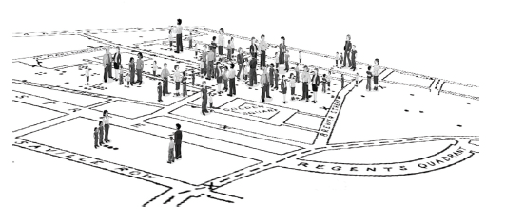
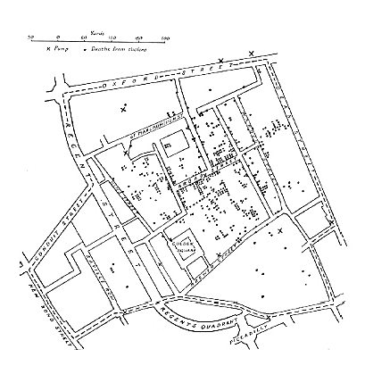
From Johanna Drucker’s “Humanities Approaches to Graphical Display”:
Figure 17. Snow's chart altered. Graphic credit Xárene Eskandar. Figure 17. Snow's chart altered. Graphic credit Xárene Eskandar.
Figure 16. Dr. John Snow’s visualization of cholera deaths in London, 1854. Graphic credit Xárene Eskandar.
“Who are those dots? Each individual had a profile, age, size, health, economic potential, family and social roles. […] But what if we take the rate of deaths, their frequency, and chart that on a temporal axis inflected by increasing panic. Then give a graphical expression to the shape of the terrain, that urban streetscape, as it is redrawn to express the emotional landscape. Then imagine drawing this same streetscape from the point of view of a mother of six young children, a recent widow, a small child, or an elderly man whose son has just died” (Drucker, “Humanities Approaches”).

Slide 24
Graphesis
Johanna Drucker: graphesis = “the field of knowledge production embodied in visual expressions … a visual epistemology” (Drucker, “Graphesis” 2011)
Visual forms carry the assumptions and values of their fields of origin, and impose these assumptions and values on the data they present, whether these assumptions and values are appropriate to that data or not.
As humanists, we ask ourselves: What arguments, values, and perspectives do visualizations encode and embody? What kind of knowledge do they produce? What field’s assumptions do they draw from?

Slide 25
Data vs. Capta
Data: “given”, objective, observed
Quantitative approaches: from concordances to corpora, from measuring word frequencies and stylometric patterns to thematic discovery through topic modelling
Visual representations of quantities, trajectories, measurable relationships
Wordle, Gephi, Cytoscape; pie charts, bar charts, and bubble graphs
Capta: “captured”, constructed, interpreted, subjective
Qualitative approaches: visual and performative, enacting poetics, making subjectivity and interpretation visible
Maps and timelines of literary narratives; digital collections; interpretive visualizations
Neatline, Neatline Time, Omeka

Slide 26
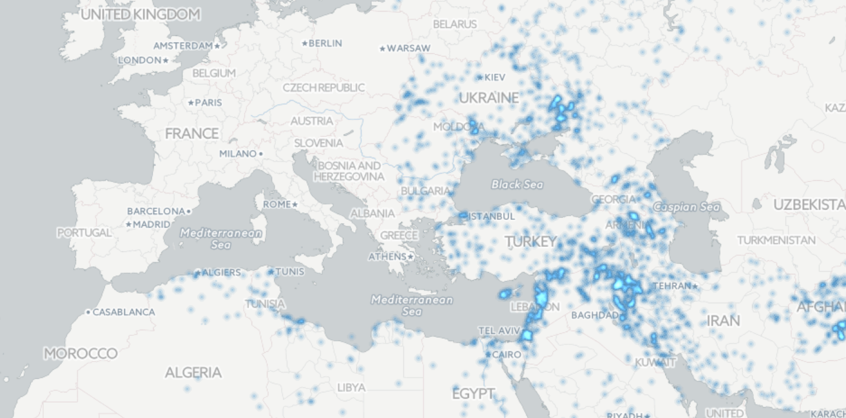
Data vs. Capta: Two Maps
GEOPOLITICAL TENSIONS IN MENA (Middle East & Northern Africa)

Slide 27
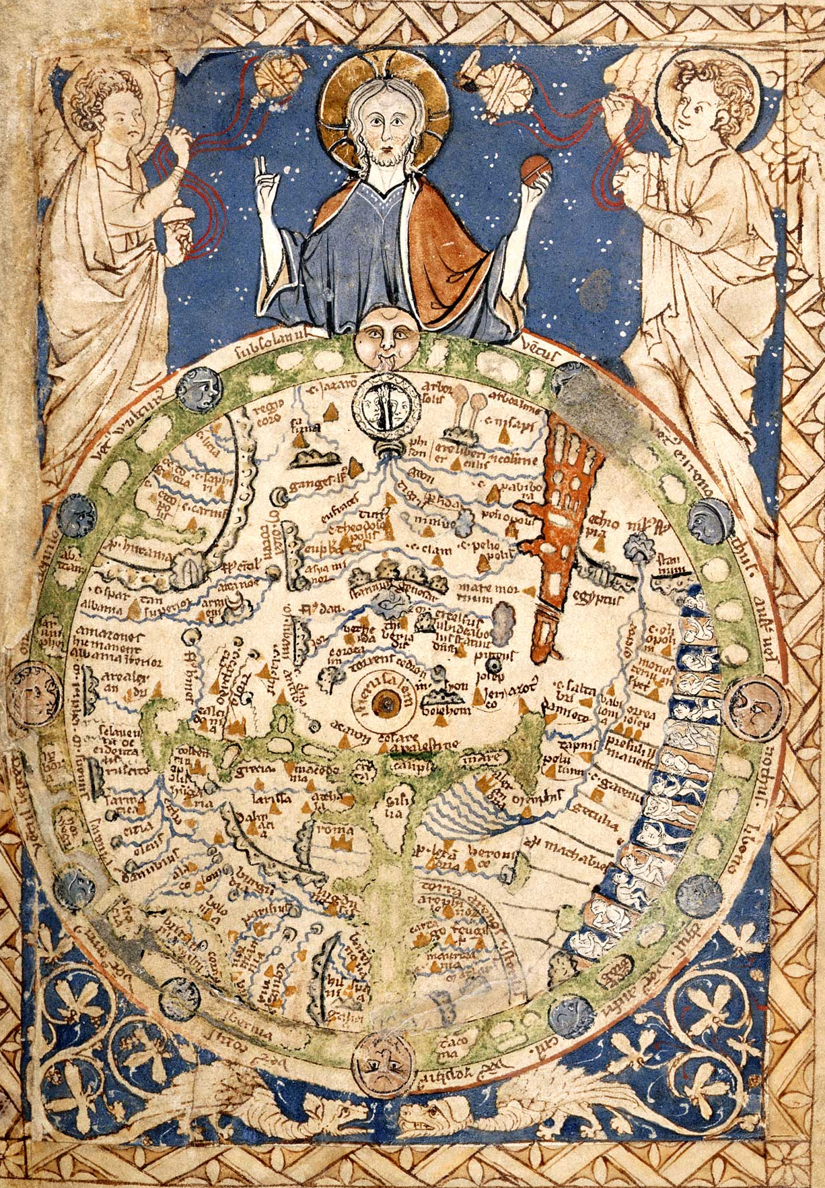
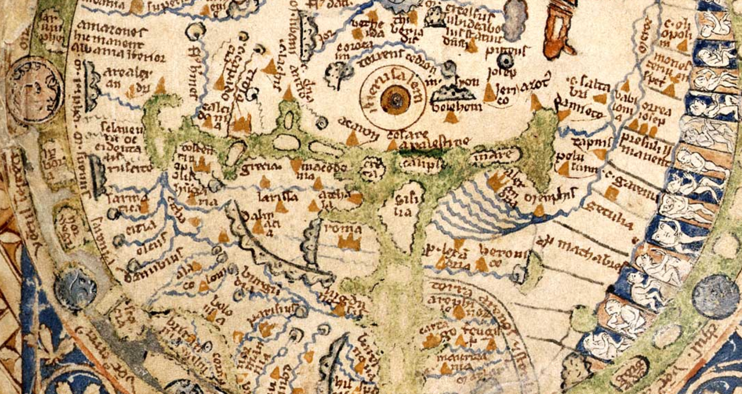
Data vs. Capta: Two Maps
BRITISH LIBRARY, The PARIS PSALTER map (c. 1300, England)

Slide 28
DH Dataviz: Examples

Slide 29
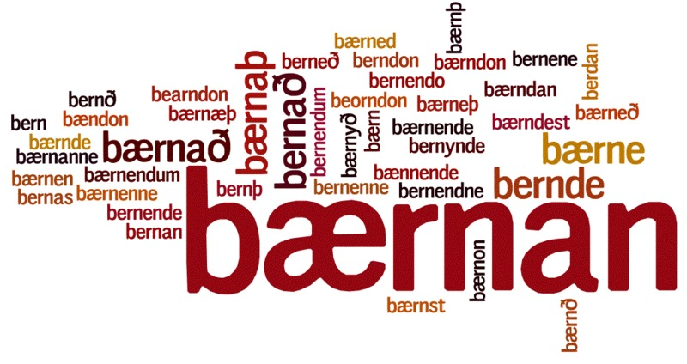
Word Cloud
Visualizes word frequencies in a text
The larger the word, the more often it appears

Slide 30
Network Graph
Network Graph:
Things: nodes (vertices)
Relationships: edges
Network

Slide 31
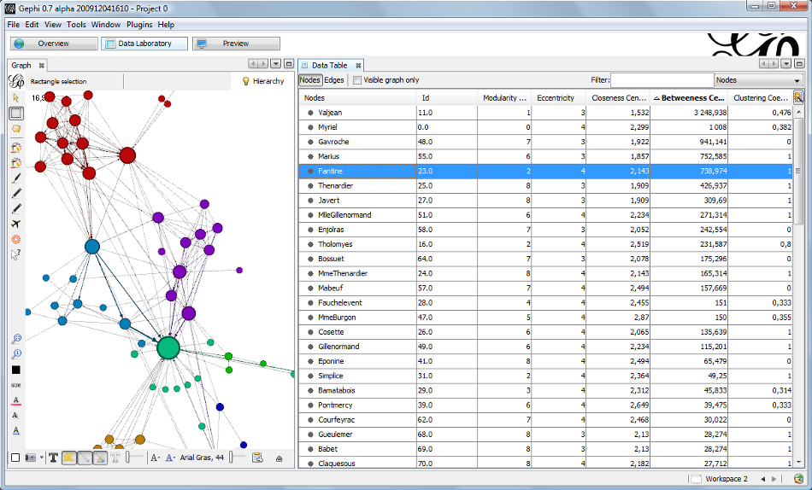
Les Miserables: Network Graph of Character Interactions
Network graph from Gephi (http://gephi.github.io/images/screenshots/datatable.png). See also Gephi Datasets (https://wiki.gephi.org/index.php/Datasets): “Coappearance weighted network of characters in the novel Les Miserables.” D. E. Knuth, The Stanford GraphBase: A Platform for Combinatorial Computing, Addison-Wesley, Reading, MA (1993).

Slide 32
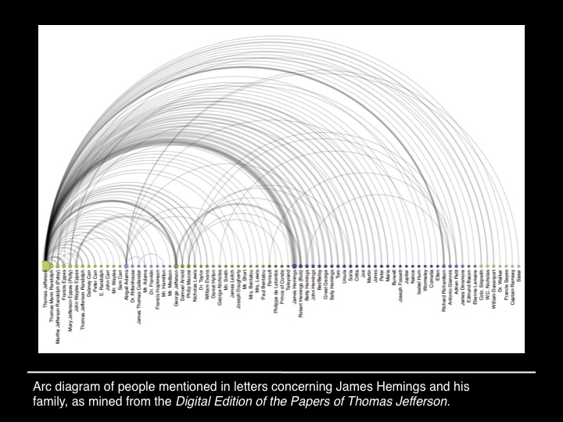
Lauren F. Klein, “A Report Has Come Here”
“This figure is James Hemings, Thomas Jefferson’s enslaved personal chef (and Sally Hemings’s older brother). When Jefferson was appointed Ambassador to France, he took Hemings with him to Paris, and there apprenticed him to the chef of a prince. Through the few archival records that relate to Hemings, we also know, for instance, that while in Paris, Hemings hired his own tutor and learned to speak fluent French. And here’s another thing Hemings learned in Paris: what it might mean to be free. […]
It is then a striking instantiation of archival silence that when you perform a “Name” search for a person named James Hemings in the The Papers of Thomas Jefferson, Digital Edition, you get no results—because Hemings, in spite of his ability to read and write in two languages–because of his status as a slave–was not a person to whom Jefferson ever wrote, or from whom Jefferson received letters.”

Slide 33
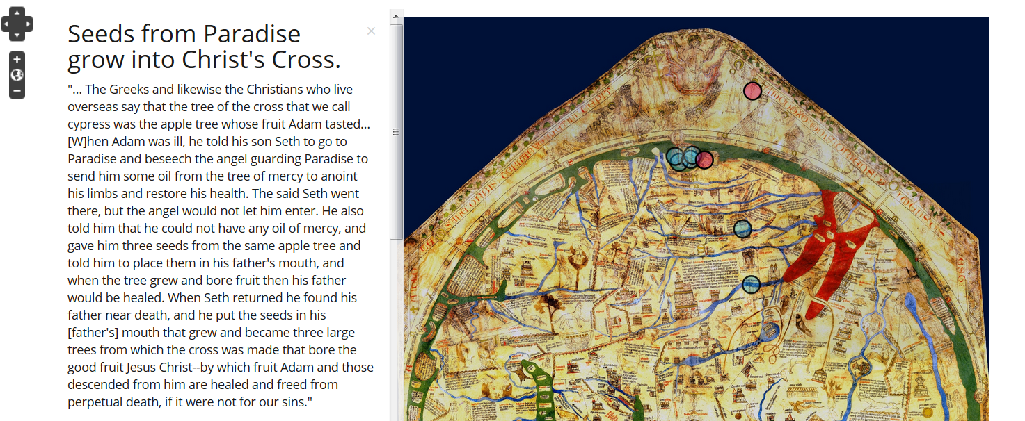
Project Paradise: A. Bolintineanu Conversation: Hereford Map & Book of John Mandeville

Slide 34
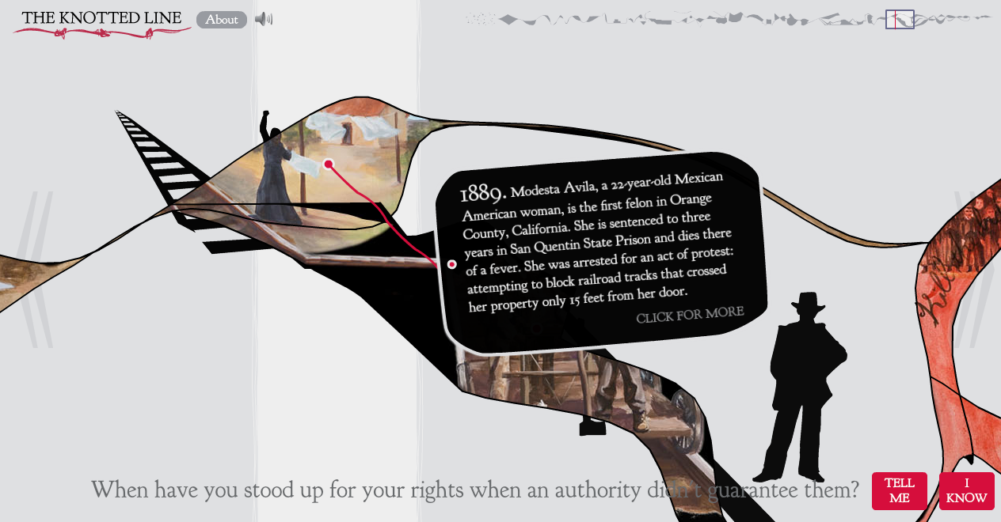
The Knotted Line
“an interactive, tactile laboratory for exploring the historical relationship between freedom and confinement in the geographic area of the United States” (http://knottedline.com/)

Slide 35
Data Visualization: Practicum

Slide 36
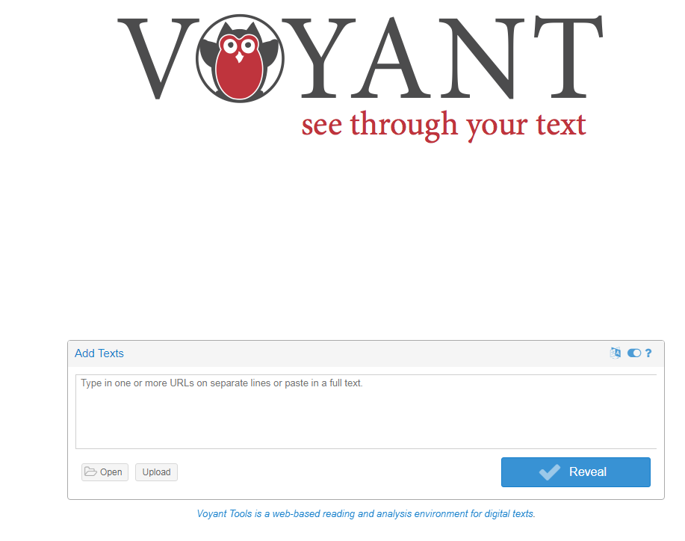
1: Text Visualization with Voyant Tools

Slide 37
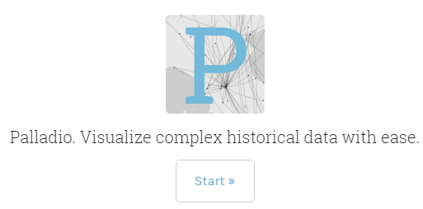
2: Maps & Networks with Palladio

